Slide 1
Vulcan Activity Tracker
CMSC-4920-Senior Project 2
Group2
Team: Margo Bonal, John Gerega, Luke Ruffing

Slide 2
Project Description
The Vulcan Activity Tracker is an athletic app that allows for the tracking of all campus athletics activities.
In one combined platform, the Vulcan Activity Tracker aspires to meet student organization needs, social interaction, and exercise goal planning in a free accessible way!

Slide 3
Weekly Progress
GOALS
Tweaking Components
Debugging
Final Presentation Slides Progress
Writing Center appointment
Finished User Manual
Prepare manual for printing

Slide 4
Challenges
Solutions
Writing the user manual with technical and detailed steps for both users and developers to navigate.
Hosting Configuration speed, server reboot time far to slow
After taking a step back and attempting to view our project as new users we found areas that needed clear instructions.
Increase # of server CPU cores

Slide 5
Progress
Vulcan Platform
Database

Slide 6
Week 14 Plan
Make a Hard Copy of User Manual
Practice Final Presentation
Continue Work on the Final Presentation Slides
Continue Testing/Debugging Project

Slide 7
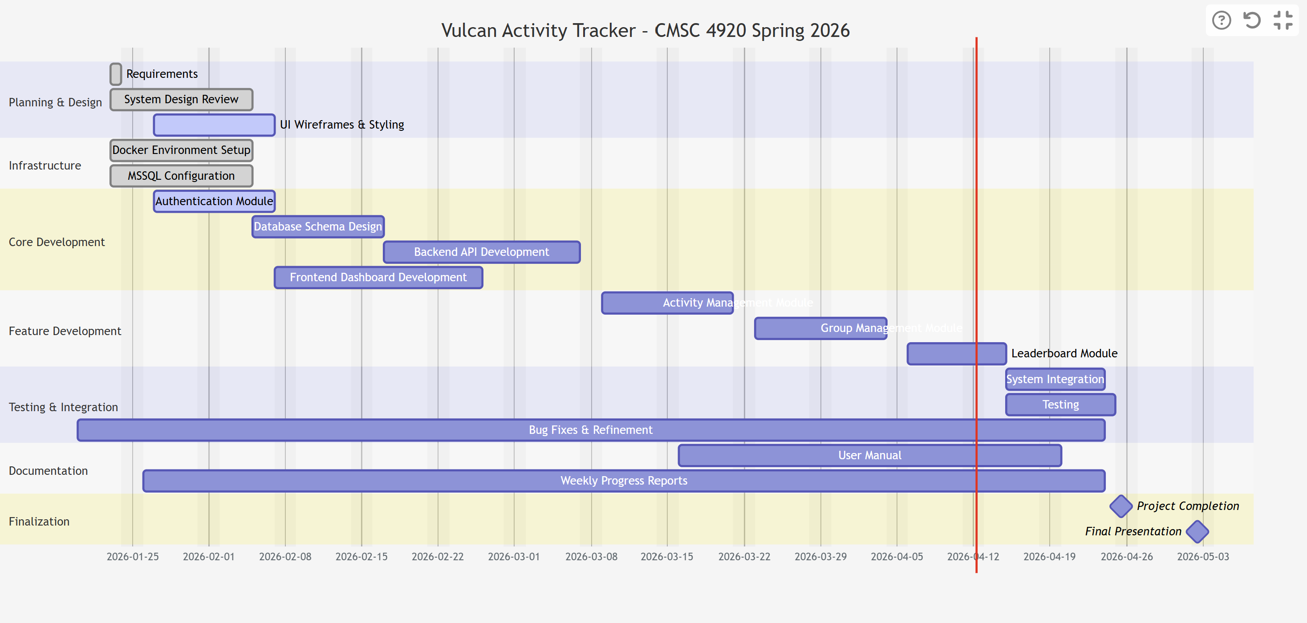
Planning
Gant chart

Slide 8
Website: https://jjdeuce06.github.io/VulcanActivityTracker/

